Slide 1
Inventory Management
In a production environment with setup time, increasing batch size can increase the capacity of the production process
With respect to capacity, increase in batch size is a favorable aspect
However, increase in batch size can increase the average inventory in the system (refer to the ABC Shirt case)
According to Little’s law, for a constant average flow rate, then higher average inventory results in higher average flow time
I.e., manufacturing lead time increases---an undesirable aspect

Slide 2
Inventory Management: Economies of Scale
In a production system, there is a fixed cost for setup, which is independent of the order size
If a firm is placing an order with supplier, then there is fixed cost of placing an order
For the items held in stock, the organization incurs holding cost (based on quantity stocked and duration of stocking)
If the required items are purchased, then the firm incurs purchase cost for the units purchased
In the production system, firm incurs production cost for the units produced
The purchase cost (production cost) is independent of the order size (batch size)
From the economic perspective, optimal order quantity (optimal production quantity) is the quantity which minimizes the total cost

Slide 3
Inventory Management under Known Demand: Continuous Review System Economic Order Quantity (EOQ) Model
Purchase cost (c/unit)
Cost incurred in purchasing a unit
Holding cost (h/unit/time)
Cost of capital
Obsolescence cost
Handling cost
Occupancy cost etc.
Fixed ordering cost (K/order)
Buyer time
Transportation cost
Receiving cost etc.

Slide 4
Economic order quantity (EOQ) Model
Assumptions:
Known and constant demand rate
No shortages
Zero lead-time (or constant lead time)
No resource limitation
Cost of inventory analysis is negligible
Costs
Holding cost (per unit per time)
Purchase cost (per unit; independent of order size)
Fixed ordering cost ( per order)
Trade-off:
Holding cost vs ordering cost

Slide 5
Inventory Profile for EOQ model
Q= order quantity, decision variable
λ = demand rate
T = cycle length
On hand inventory
-λ
Q
T
Time, t

Slide 6
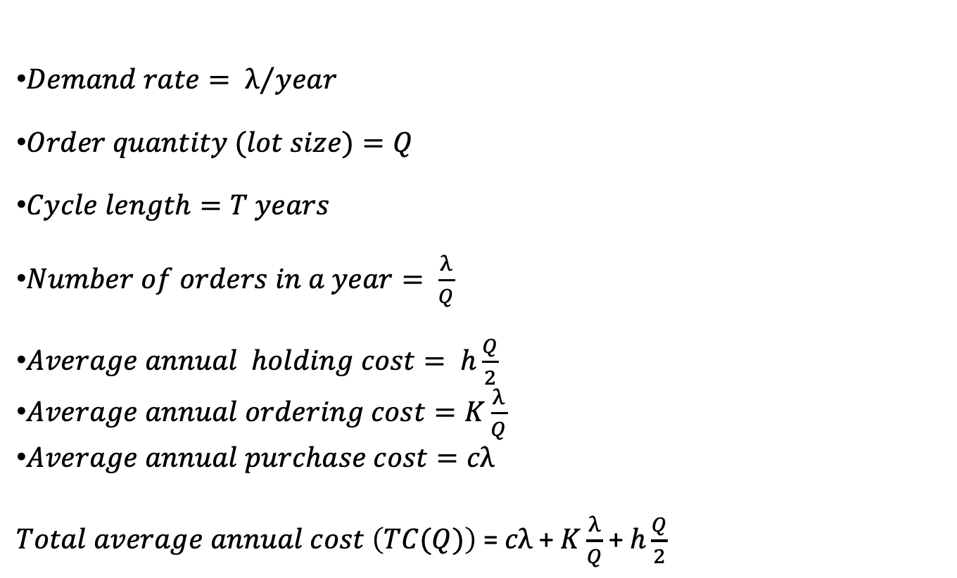
Economic Order Quantity Model
$Demand rate= λ/{year}$
$Order quantity (lot size)=Q$
$Cycle length=T years$
$Number of orders in a year= \frac{λ}{Q}$
$Average annual holding cost= h\frac{Q}{2}$
$Average annual ordering cost=K\frac{λ}{Q}$
$Average annual purchase cost=cλ$
$Total average annual cost \left(TC(Q)\right)$ = $cλ$ + $K\frac{λ}{Q}$ +$h\frac{Q}{2}$

Slide 7

Costs in Economic Order Quantity Model
Total cost
Holding cost
Cost
Purchase cost
Fixed ordering cost
$$Q^{∗}$$
Quantity

Slide 8
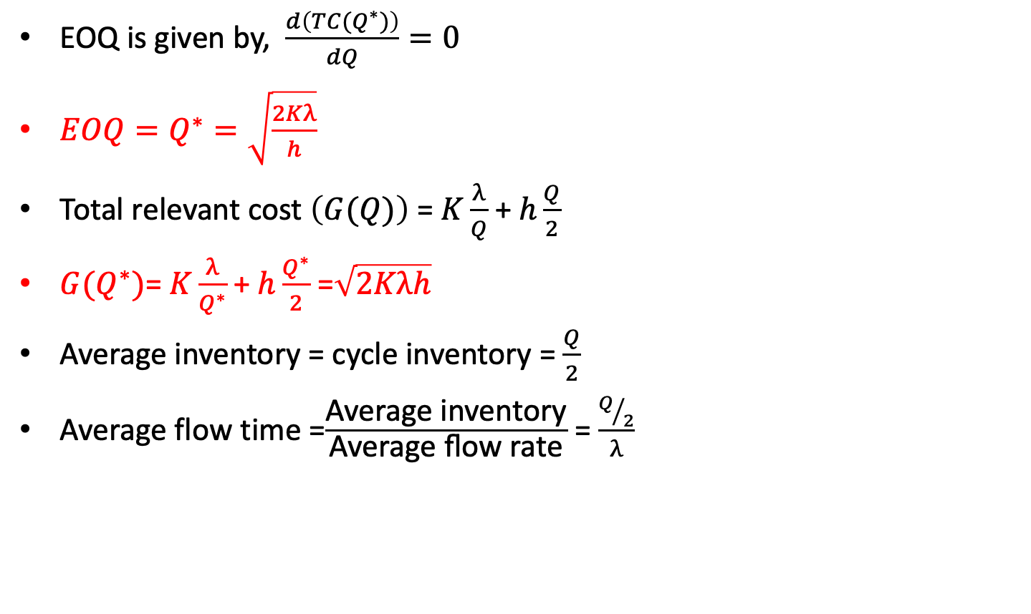
Economic Order Quantity Model
EOQ is given by, $\frac{d\left(TC{(Q}^{∗})\right)}{dQ}=0$
${EOQ=Q}^{∗}=\sqrt{\frac{2Kλ}{h}}$
Total relevant cost $\left(G(Q)\right)$ = $K\frac{λ}{Q}$ +$h\frac{Q}{2}$
$G(Q^{∗})$= $K\frac{λ}{Q^{∗}}$ +$h\frac{Q^{∗}}{2}$ =$\sqrt{2Kλh}$
Average inventory = cycle inventory = $\frac{Q}{2}$
Average flow time =$\frac{\text{Average} \text{inventory}}{\text{Average} \text{flow} \text{rate}}$ = $\frac{Q/2}{λ}$

Slide 9
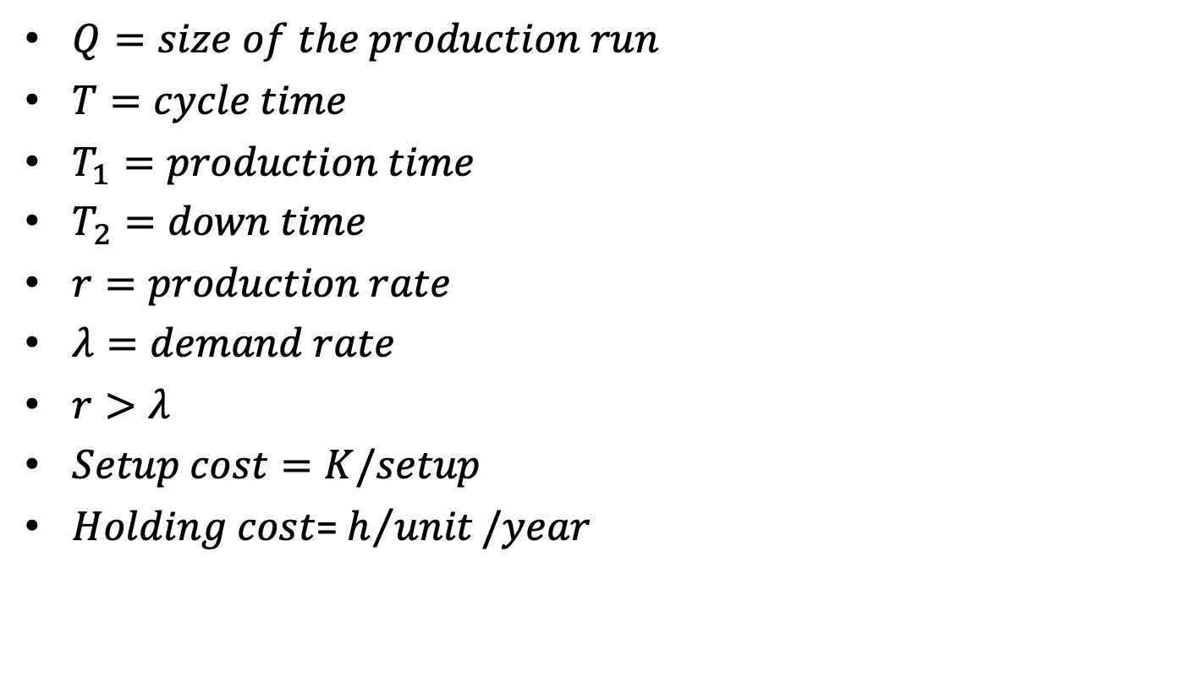
Continuous Review System Economic Production Quantity (EPQ) Model
$Q=size of the production run$
$T=cycle time$
$T_{1}=production time$
$T_{2}=down time$
$r=production rate$
$λ=demand rate$
$r>λ$
$Setup cost=K/setup$
$Holding cost$= $h/{unit}/year$

Slide 10

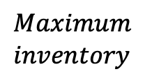






Economic Production Quantity (EPQ) Model
Inventory
$$Q$$
$$Maximum$$
$$inventory$$
$$r$$
$$−λ$$
$$r−λ$$
$$T_{1}$$
$$T_{2}$$
$$T$$
Time

Slide 11
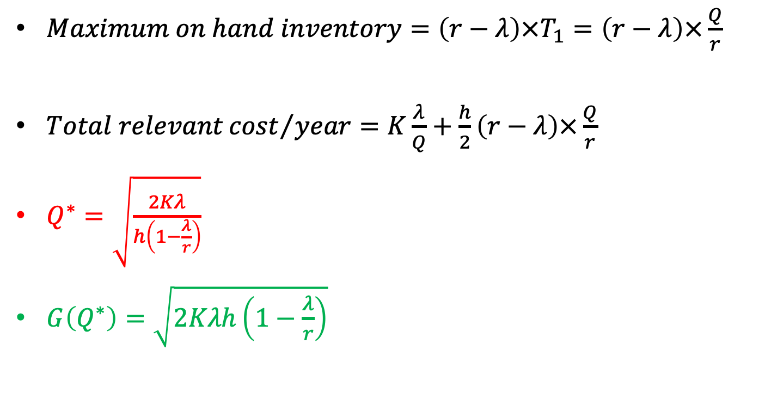
Economic Production Quantity (EPQ) Model
$Maximum on hand inventory=\left(r−λ\right)×T_{1}=\left(r−λ\right)×\frac{Q}{r}$
$Total relevant{cost}/{year}=K\frac{λ}{Q}+\frac{h}{2}\left(r−λ\right)×\frac{Q}{r}$
$Q^{∗}=\sqrt{\frac{2Kλ}{h\left(1−\frac{λ}{r}\right)}}$
$G\left(Q^{∗}\right)=\sqrt{2Kλh\left(1−\frac{λ}{r}\right)}$

Slide 12
Example 1
Landmark sells Pilot ink pen imported from Japan. Per unit cost of the pen is Rs. 2000. Annual holding cost is based on 20% interest rate. Fixed ordering cost is Rs. 1000. Monthly demand is 50. If the lead time is three months, and Landmark follows continuous review policy, when should the order be placed and how much should be the order size, which minimizes the total cost?

Slide 13
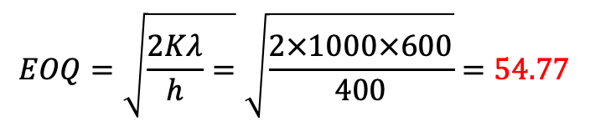
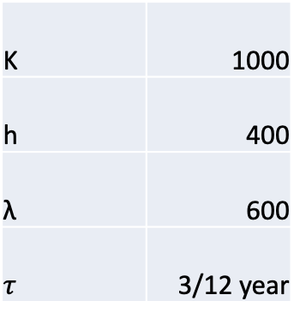

K | 1000
h | 400
λ | 600
$$τ$$ | 3/12 year
$$EOQ=\sqrt{\frac{2Kλ}{h}=}\sqrt{\frac{2×1000×600}{400}}=54.77$$
$$R=λτ=150$$

Slide 14
Example 1
Landmark sells Pilot ink pens that they manufacture. The per unit production cost of the pen is Rs. 2000. Annual holding cost is based on a 20% interest rate. The fixed setup cost is Rs. 1000. The annual production rate is 1000 units. The monthly demand is 50. How much should be the optimal production size for Landmark? Is manufacturing better than purchasing in the context of Landmark?

Slide 15
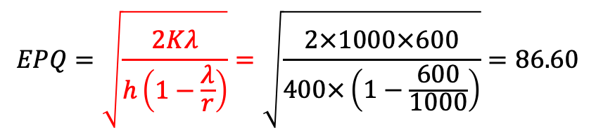
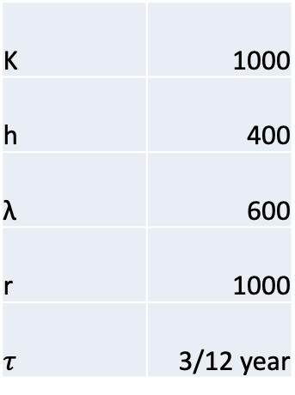
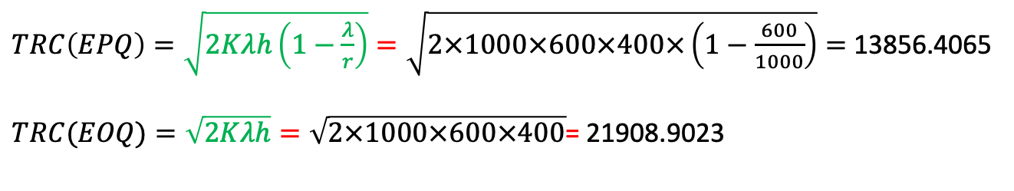
K | 1000
h | 400
λ | 600
r | 1000
$$τ$$ | 3/12 year
$$EPQ=\sqrt{\frac{2Kλ}{h\left(1−\frac{λ}{r}\right)}}=\sqrt{\frac{2×1000×600}{400×\left(1−\frac{600}{1000}\right)}}=86.60$$
$TRC\left(EPQ\right)=\sqrt{2Kλh\left(1−\frac{λ}{r}\right)}=\sqrt{2×1000×600×400×\left(1−\frac{600}{1000}\right)}=$ 13856.4065
$TRC(EOQ)=\sqrt{2Kλh}=\sqrt{2×1000×600×400}$= 21908.9023
Producing is cheaper than manufacturing in this context. Hence, the firm will be better off by internal manufacturing.

